Slide 1
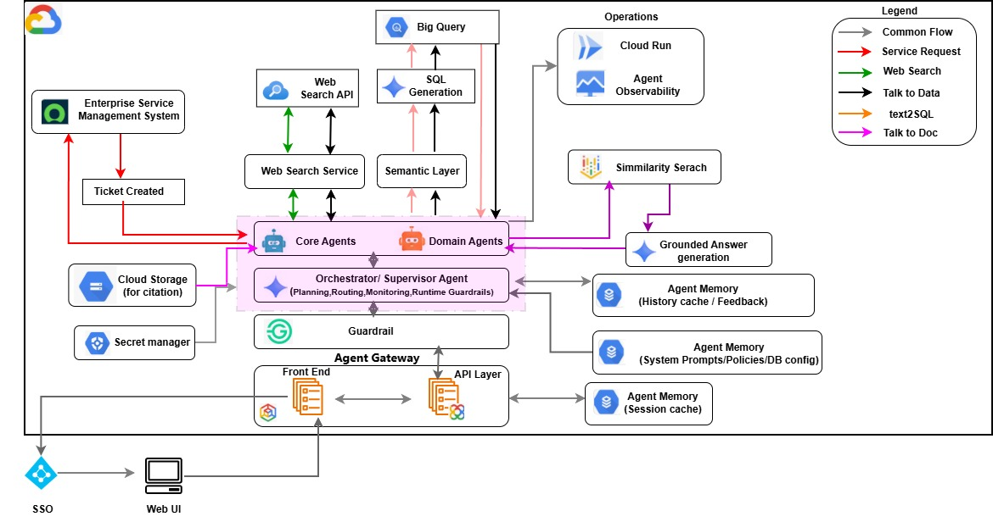
Semantic & Agentic AI Architecture-GCP

Slide 2
Semantic & Agentic AI Architecture-GCP
Section | Description
Web UI and SSO | The Web UI is the enterprise interaction point for users, while SSO provides the authenticated entry path into the platform. Together they establish who the user is before any orchestration, policy, or capability routing begins.
Agent Gateway (Front End / API Layer) Data Ingestion | The Agent Gateway is the ingress and routing edge for the intelligent agent runtime. It separates user-facing access from service invocation, allowing frontend interactions and API-driven execution to converge into one controlled agent platform entry point.
Guardrail | The Guardrail layer is the first safety and policy checkpoint before orchestration begins. It enforces policy controls, blocks jailbreak attempts, prompt injection, and other unsafe or disallowed inputs, and also filters unsuitable or non-compliant content before the final model response is returned. This ensures both request intake and response output remain governed and enterprise-safe..
Orchestrator / Supervisor Agent | The Orchestrator / Supervisor Agent is the control brain that interprets intent, applies planning, routing, monitoring, and runtime guardrails, and selects the right execution path. It directs requests across the five supported capabilities: Service Request, Web Search, Talk to Data, Text2SQL, and Talk to Doc. It then coordinates intermediate outputs and assembles the final governed response.
Core Agents and Domain Agents | Core Agents provide reusable execution capabilities such as Retrieval & Grounding, Analytics/SQL Insights, Action & Workflow, Evaluation, and Monitoring, while Domain Agents such as HR, Finance, Sales, and IT apply those capabilities within specific business contexts. They work in coordination: the Orchestrator routes the request, Core Agents handle the capability logic, and Domain Agents add business context, domain rules, and the right system/data path where needed. Together, this layer turns generic AI capabilities into enterprise-ready execution across service requests, document search, structured-data interaction, and domain-specific user scenarios

Slide 3
Semantic & Agentic AI Architecture-GCP
Section | Description
Enterprise Service Management System and Ticket Created | This path represents the workflow / service-request capability. When the orchestrator chooses an action workflow, the agent layer integrates with the enterprise service management system to create a ticket or request and return the generated status back into the NEO response path
Web Search Service and Web Search API | These components represent the external search capability path. The Web Search Service acts as the execution layer for external-current-information retrieval, while the Web Search API is the backend interface used to fetch approved web results when the request requires internet-facing context
Semantic Layer | The Semantic Layer provides the governed business meaning needed for data-oriented agent execution. It sits between agents and BigQuery so structured-data questions are translated through business definitions and semantic understanding before SQL is generated and executed.
SQL Generation | SQL Generation is the point where semantically interpreted intent becomes an executable data query. It converts the structured-data request into SQL that can be run on BigQuery, making the Text2SQL and talktodata-query flow operational
BigQuery | BigQuery is the structured-data execution backend for data retrieval and analytics. It is where governed SQL queries are executed and where structured enterprise insights are returned for Talk-to-Data and Text2SQL style experiences.
Similarity Search | For the Talk to Doc capability, Similarity Search is the retrieval backbone that identifies the most relevant document chunks or citation-backed enterprise content. It supplies the grounded evidence needed for document-based answering, so the final response is based on retrieved knowledge rather than only on model priors.

Slide 4
Semantic & Agentic AI Architecture-GCP
Section | Description
Grounded Answer generation | This component transforms retrieved semantic or document context into a final grounded response. It is the stage where retrieved evidence is assembled into a user-facing answer, ensuring the platform returns an interpreted response
Cloud Storage (for citation) | For Talk to doc ,Cloud Storage represents the source location for citation-backed content on the document-search path. It supports retrieval and grounding by providing the persistent file-level or chunk-level content that can be cited, referenced, and used for evidence-based answers
Agent Memory – History cache / Feedback | This memory store captures conversational history and feedback needed for continuity, learning, and interaction tracking. It allows the runtime to reuse prior session context and user feedback signals during ongoing interactions.
Agent Memory – System Prompts / Policies / DB config | This memory/config store contains runtime prompt definitions, policy context, and database configuration dependencies that shape agent behavior. It provides the control inputs that help the orchestrator and agent layer behave consistently, securely, and according to platform rules.
Agent Memory – Session cache | The session cache holds short-lived runtime context needed for active interaction continuity. It improves responsiveness and keeps current-session state available without re-resolving every context dependency on each step.
Secret Manager | Secret Manager supplies credentials and protected configuration required for secure backend access. It is shown as a shared runtime dependency because orchestration and agent execution need secure secrets to interact with enterprise systems, APIs, and platform services
Operations | The Operations block represents the hosting and observability model for the intelligent agent runtime. Cloud Run provides the execution environment for services, while agent observability captures logs, telemetry, and runtime health needed for production operations.

